Slide 1
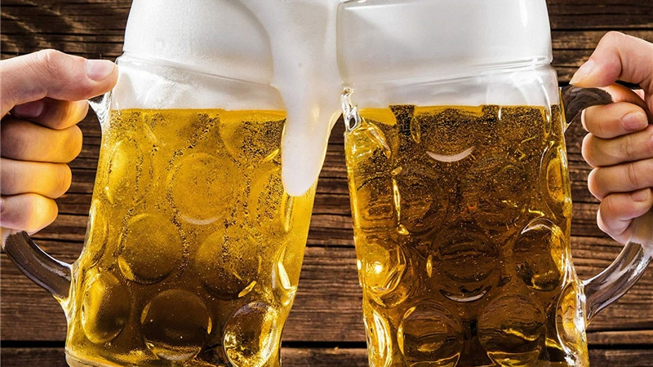
Recipe Writing without a Program
Take Control of Your Beer!

Slide 2
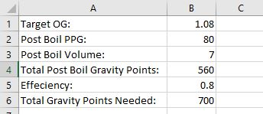
Start with the basics…
There are three things you need to know to get started:
Your target OG
2. Your post boil volume
3. Your efficiency

Slide 3
This brings us to the grains…
We then use a formula to get the gravity point contributions of each grain by percentage of the grain bill.
Then we use another simple formula to get the grist by weight for each grain, for this we need some outside help…
We start by listing our grains and their percentage of the grain bill.

Slide 4
Outside Help…
We get our potential extract for each malt from this table.
Always use the Max PPG Column!!!

Slide 5
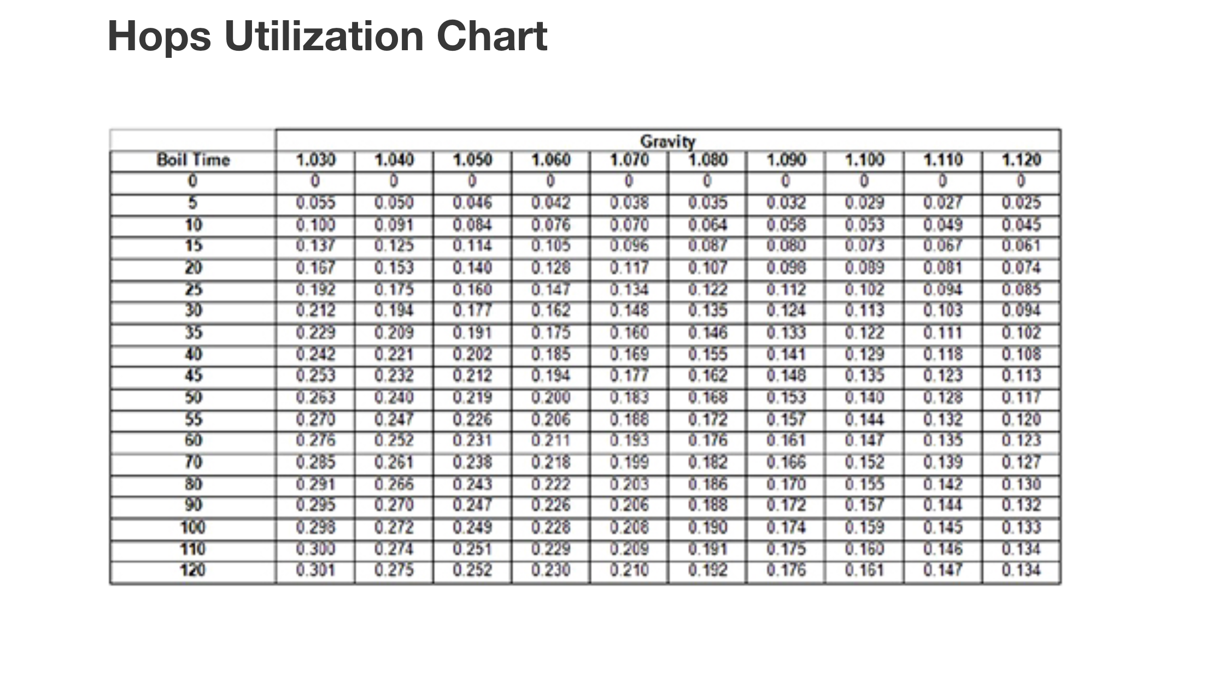
Lets talk IBU’s…
This is my preferred way to calculate IBU’s because it is easy to replicate and stay consistent:
X= (7489 x AA x W x Z)/PBV
X=IBU’s
AA= Alpha acid content of hops
W= Weight of hops
Z= Value derived from table
PBV= Post boil volume
There are lots of ways to calculate IBU’s
The most important thing is consistency
Over time you will develop a sense for what different IBU levels mean to you

Slide 6
IBU’s Continued…
This means to hit our goal IBU we need to get 31 IBU’s from the bittering hops. Since we know the IBU (X) we will work the formula differently to find the weight of the bittering hops that we need to use to get 35 total IBU’s.
Our equation is as follows:
31=(7489 x W x .142 x .176)/7
217=187.17W
W= 1.2oz
W= (1.2 x 28.35)= 33g
Start by deciding what your target IBU level is based on your recipe
Then we calculate the aroma hops IBU contribution…
In our example this equals:
X=(7489 x .059 x 1 x .064)/7= 4 IBU

Slide 7
Final Recipe Steps…

Slide 8
Add your notes, deviations, and other misc info for data tracking…

Slide 9
Sources:
/
http://howtobrew.com/book/section-2/what-is-malted-grain/table-of-typical-malt-yields
https://blog.homebrewing.org/how-to-calculate-ibus
To calculate ABV:
https://www.brewersfriend.com/abv-calculator/

